Slide 1




SIMPLIFYING PHARMA LINK WITH ODOO

Slide 2
Our Team
HAGAR SHAWKY
MOHAMED HAMDY
DAVID EMAD
HEBA FAISAL
MOHAMED HASSAN
BOULA WAEL

Slide 3
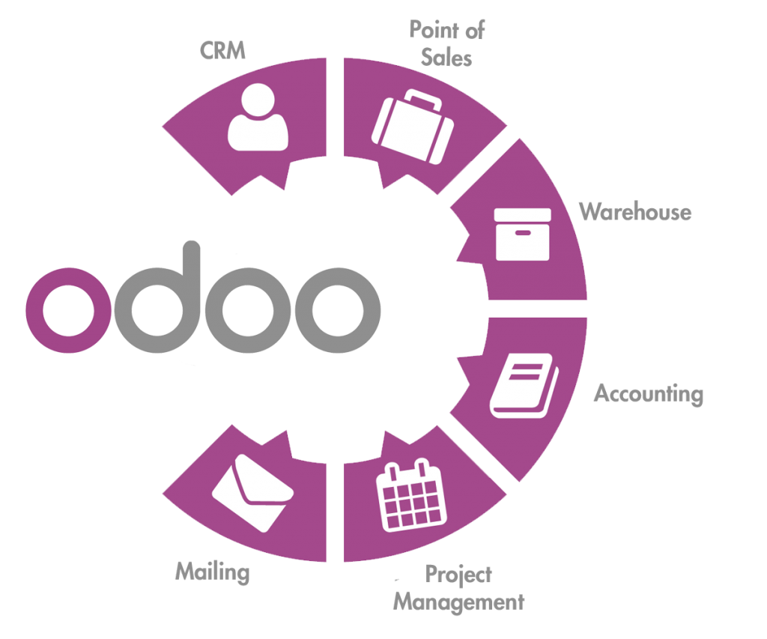
Content
Introduction
Business Model
Analysis
Implementation

Slide 4

Introduction
Pharma Link faced supply chain challenges—inefficient inventory management, order delays, and supplier coordination issues—that disrupted operations and product availability.
This project aims to solve these problems by implementing Odoo ERP, streamlining procurement, automating inventory, and enhancing supplier connections. With Odoo, Pharma Link will improve efficiency, ensuring better service for pharmacies and customers alike.

Slide 5
Objectives & Goals
Objectives
Streamline Supply Chain: Optimize procurement, inventory, and supplier coordination with Odoo ERP.
Automate Operations: Reduce manual tasks and minimize delays in order processing.
Increase Visibility: Provide real-time data for better decision-making.
Goals
Improve Efficiency: Ensure faster access to essential products.
Enhance Supplier Relations: Strengthen and simplify supplier partnerships.
Boost Customer Experience: Deliver timely, reliable service for both pharmacies and consumers.

Slide 6
Company Overview
Pharma Link revolutionizes the pharmaceutical supply chain by connecting pharmacies directly with suppliers through a seamless B2B and B2C marketplace.
Our platform empowers businesses to:
Efficiently manage inventory
Optimize procurement processes
Enhance customer delivery
With a comprehensive view of the supply chain, Pharma Link ensures that essential medications are always available, transforming the way healthcare is delivered.

Slide 7
Why Choose Odoo ERP?
Comprehensive Functionality
Customization
User-Friendly Interface
Scalability
Open Source
Strong Community Support
Cost-Effective

Slide 8
Purchase Module
vendors
purchase order
call for tenders
purchase reports

Slide 9
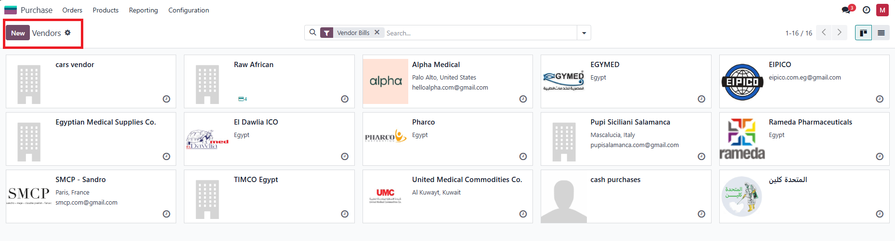
vendors

Slide 10
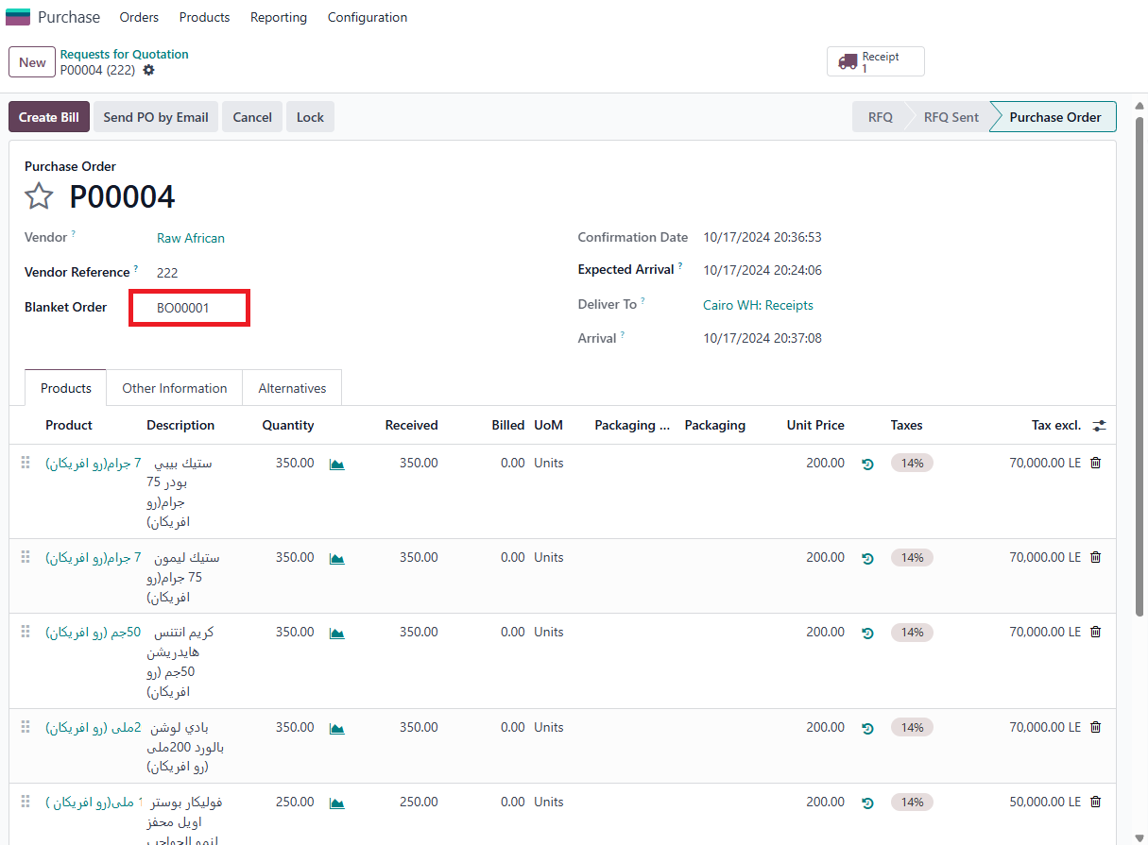
Purchase Order (Blanket Order)

Slide 11
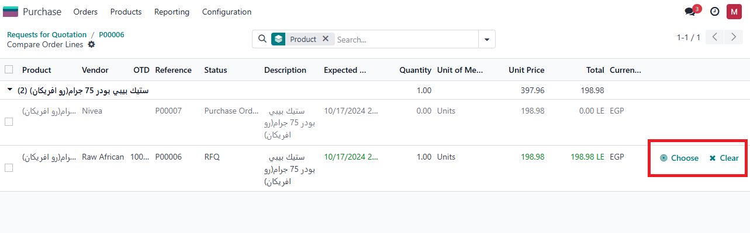
call for tenders

Slide 12
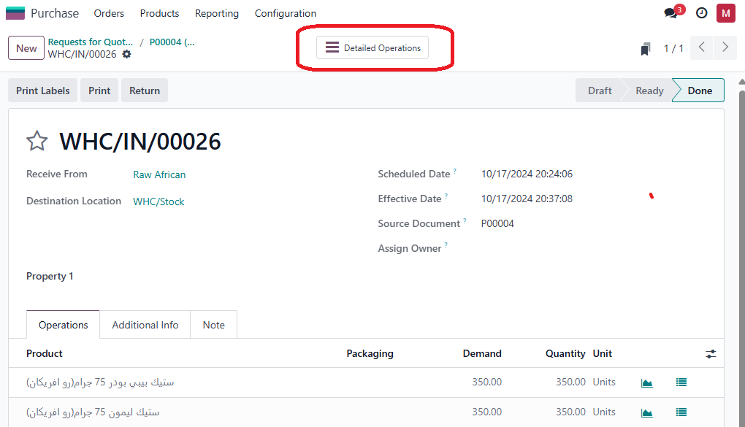
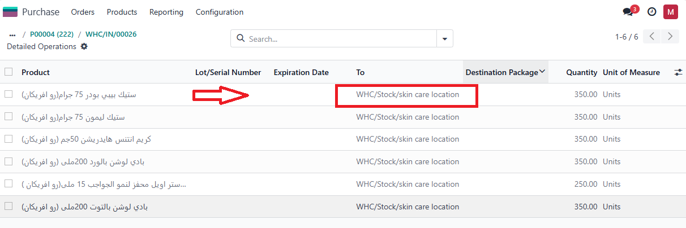

Slide 13
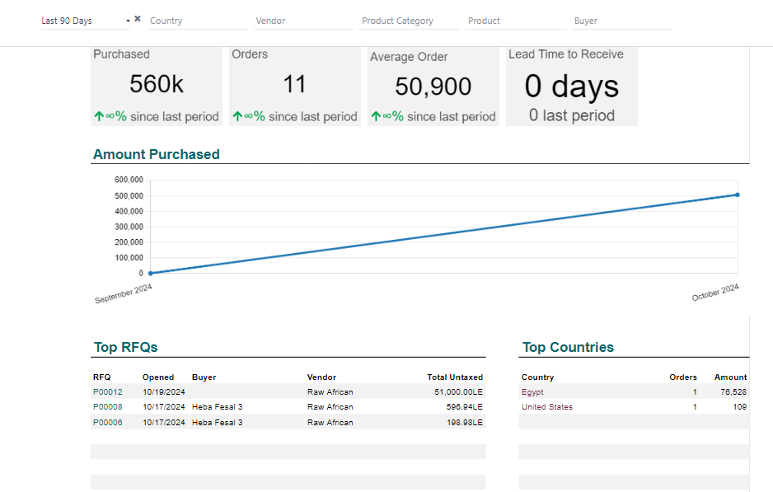
Purchase Report

Slide 14
Inventory Module
products
inventory warehouses
removal strategy
inventory location
virtual location
product category
putaway rules
recording rules
scrup
inventory check
inventory report
inventory flow

Slide 15
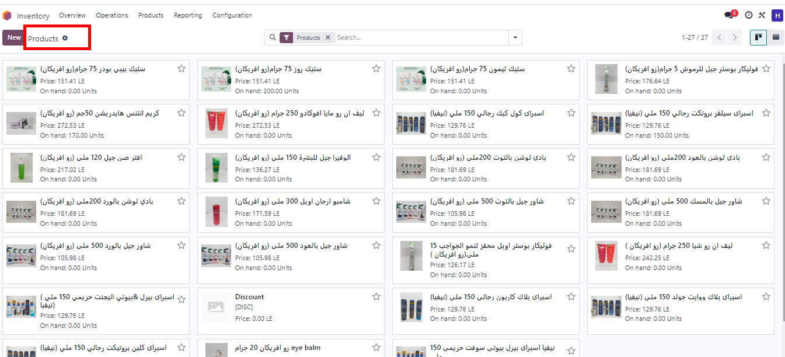
Products

Slide 16
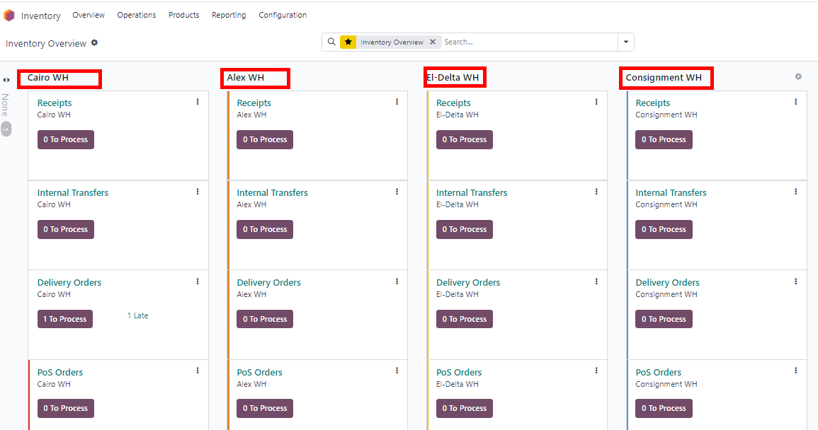
Inventory Warehouses

Slide 17
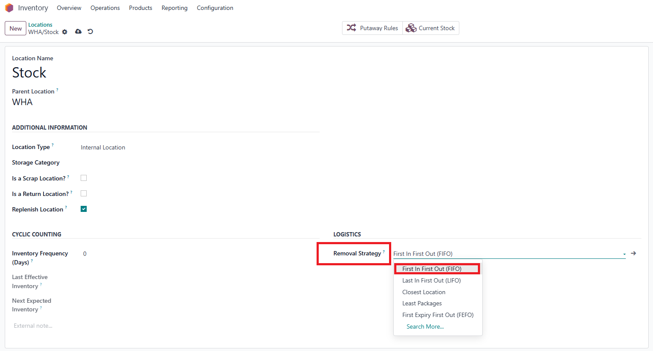
Removal Strategy :

Slide 18
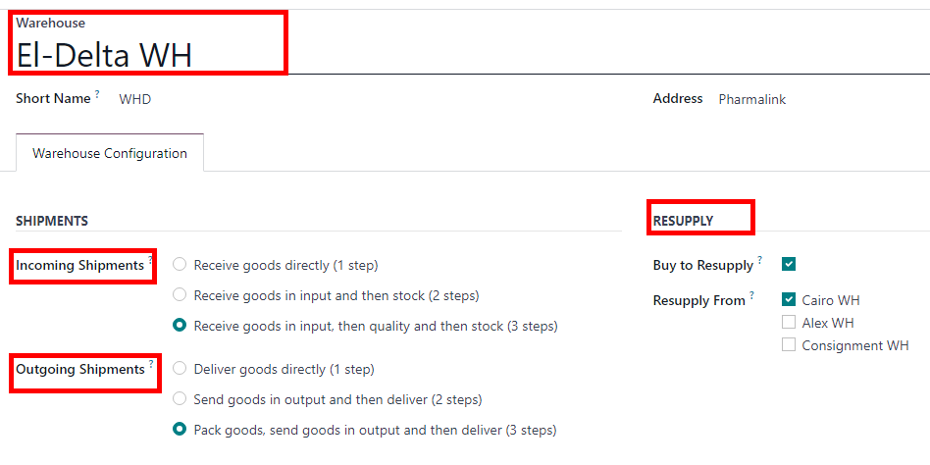
DELTA Warehouses
Resupply from Cairo WH
Incoming Shipments and Outgoing Shipments In 3 Steps To Check Quality

Slide 19
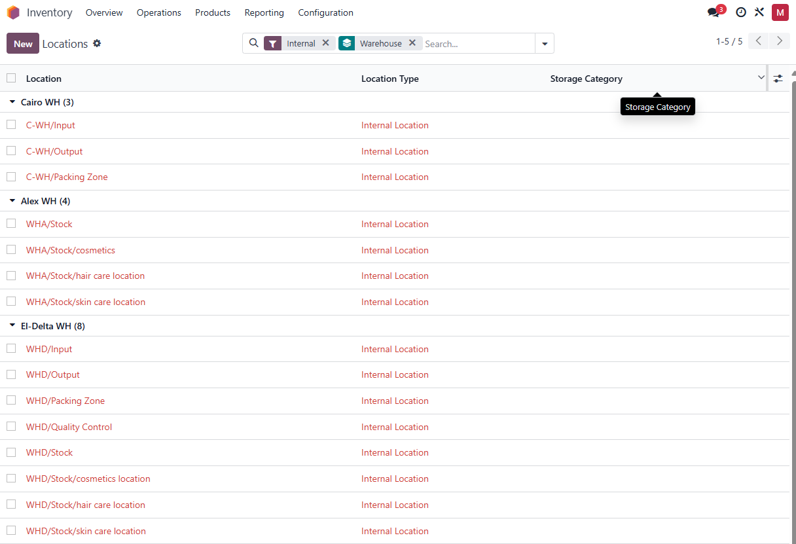
Inventory Locations

Slide 20
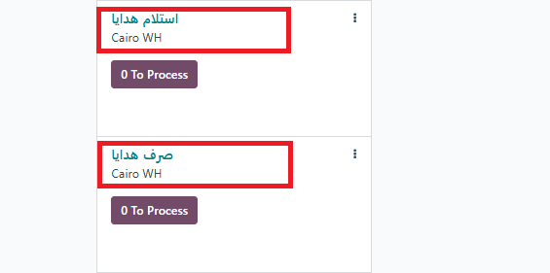
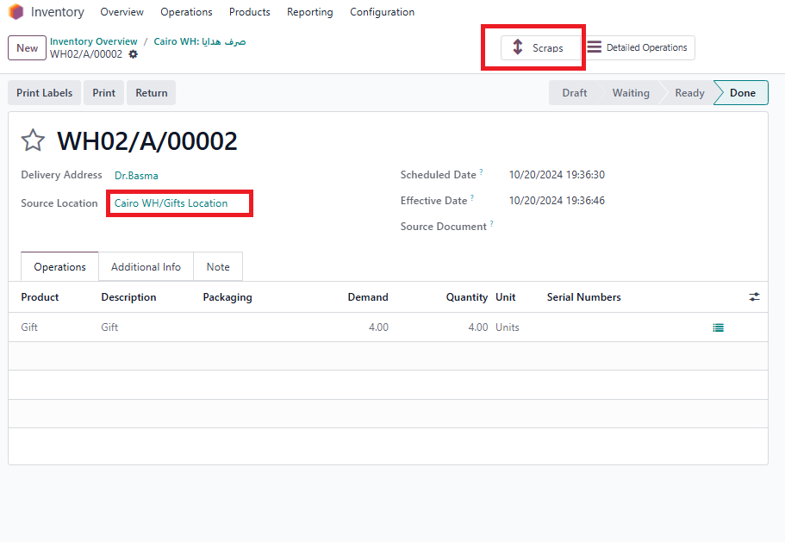
Virtual Location

Slide 21
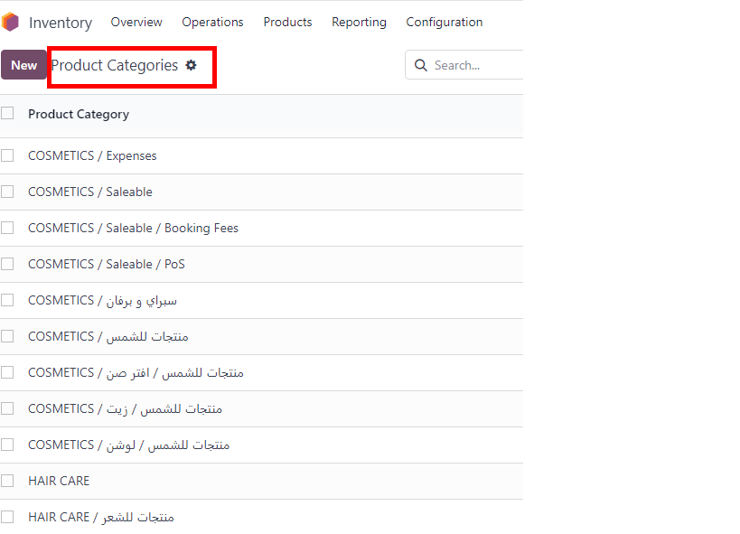
Product Category

Slide 22
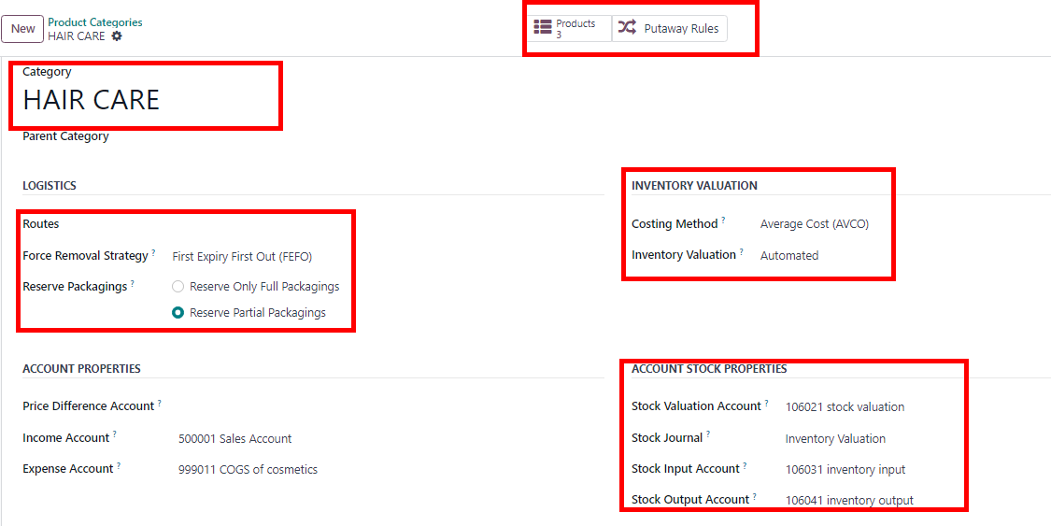
Example of product category

Slide 23
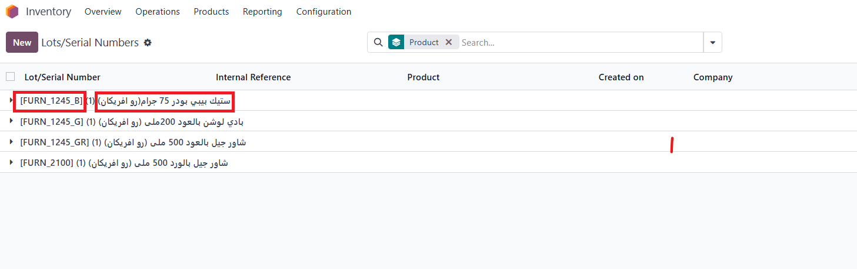
Lots/Serial Numbers

Slide 24
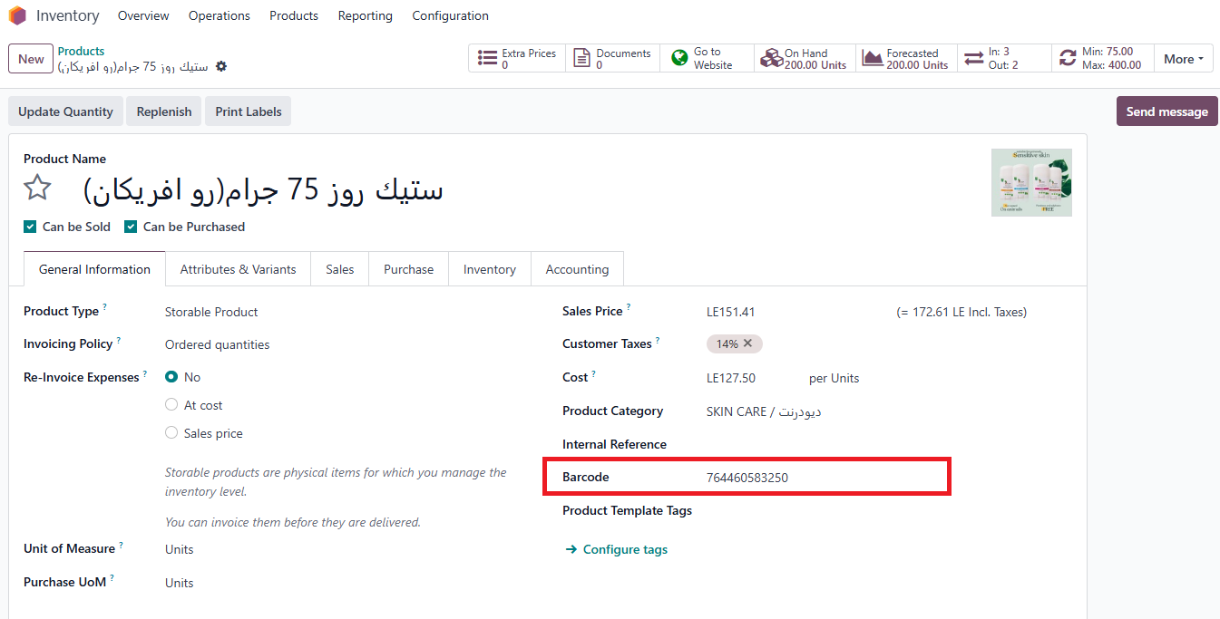
Products with Barcode :

Slide 25
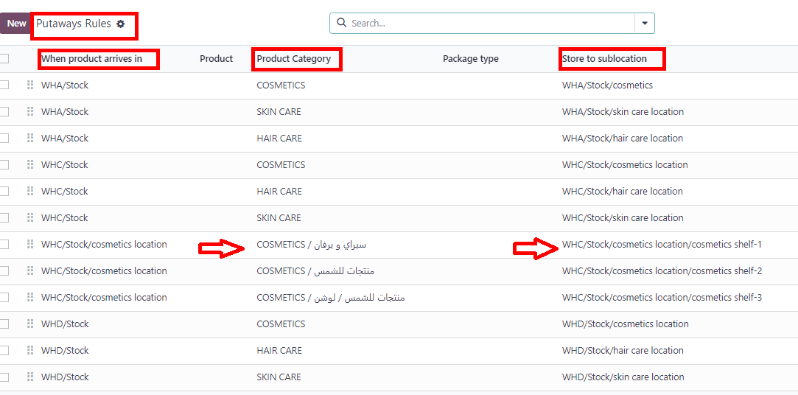
Putaways Rule

Slide 26
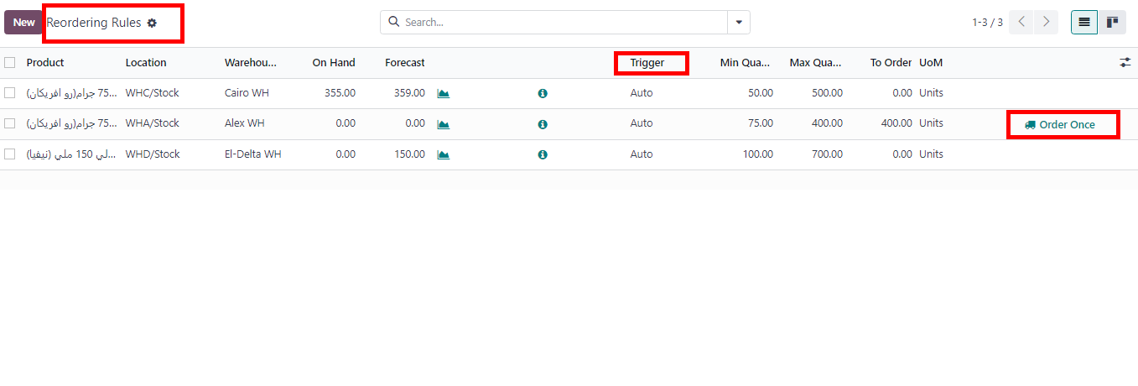
Reordering Rules

Slide 27
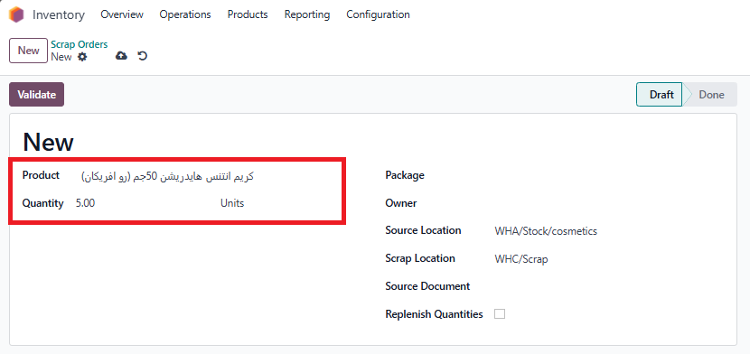
Scrap

Slide 28
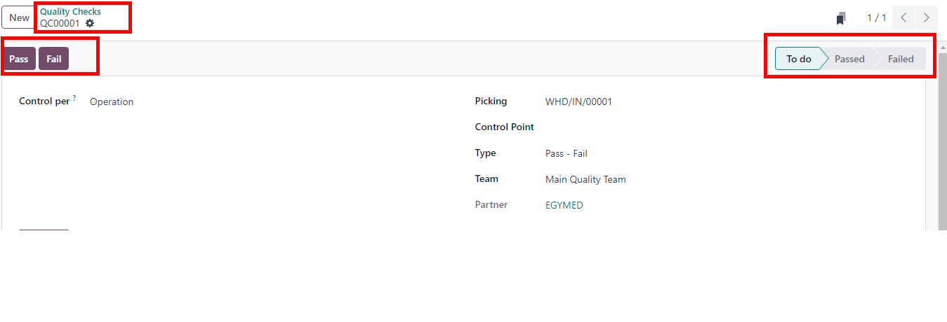
Quality check

Slide 29
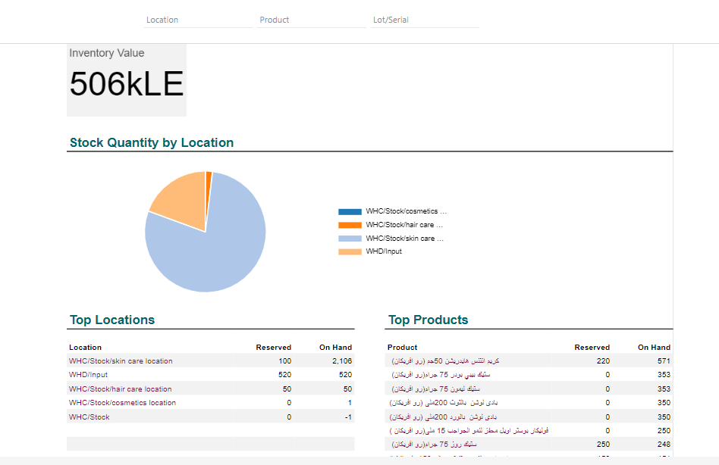
Inventory Report

Slide 30
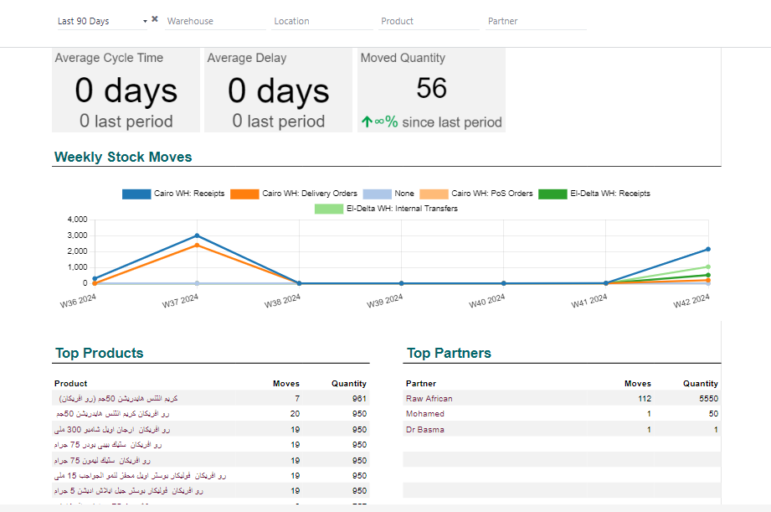
Inventory Flow

Slide 31
Sales Module
CUSTOMER
Pricelist
Shipping Method
Sales Order
Sales Report
point Of Sales

Slide 32
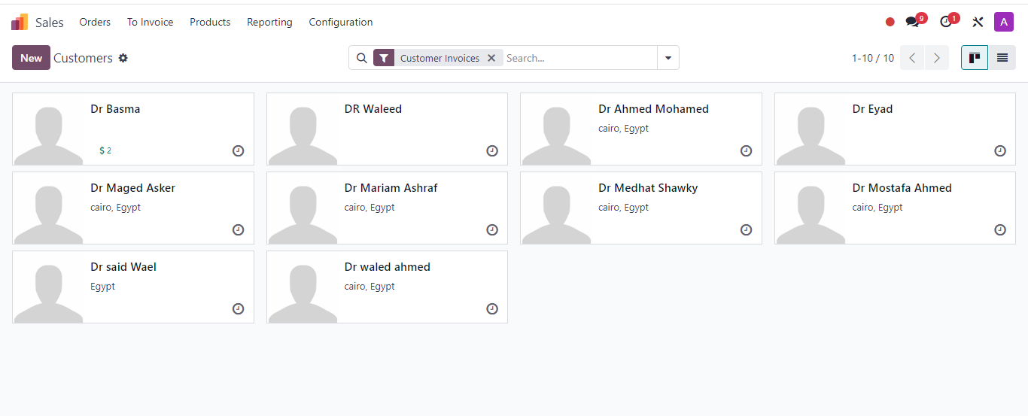
Customers

Slide 33
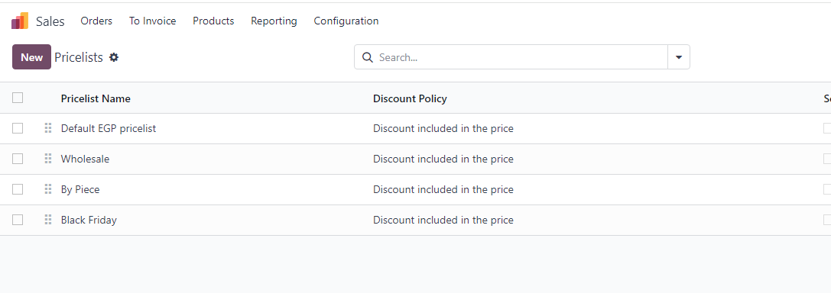
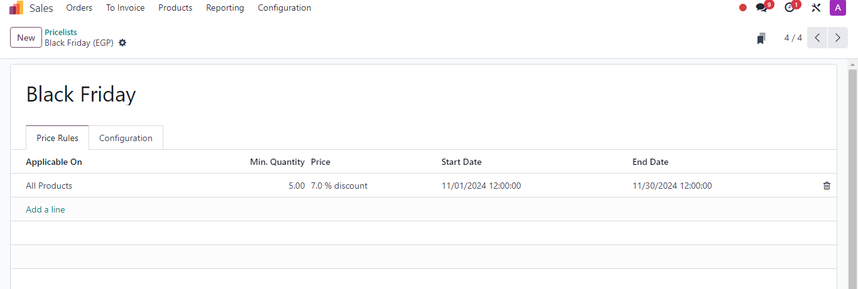
Pricelists :
Example :

Slide 34
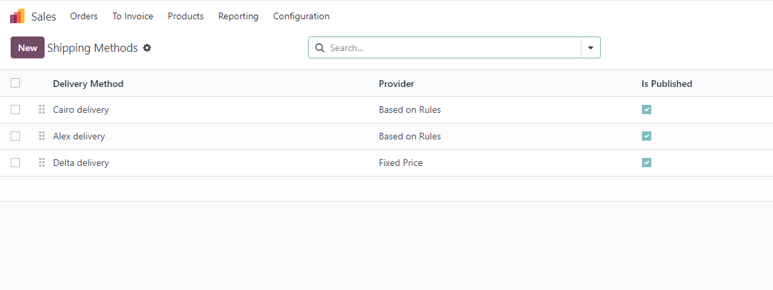
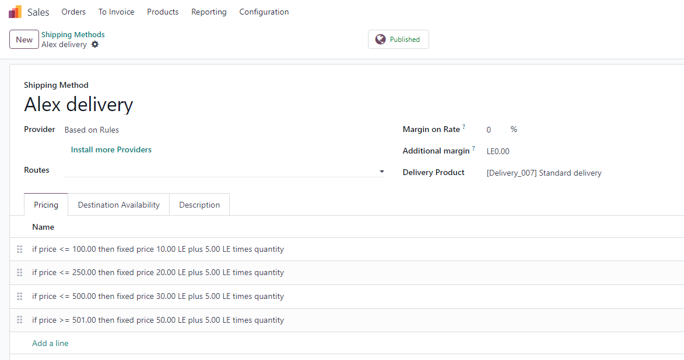
Shipping Methods :
Example :

Slide 35
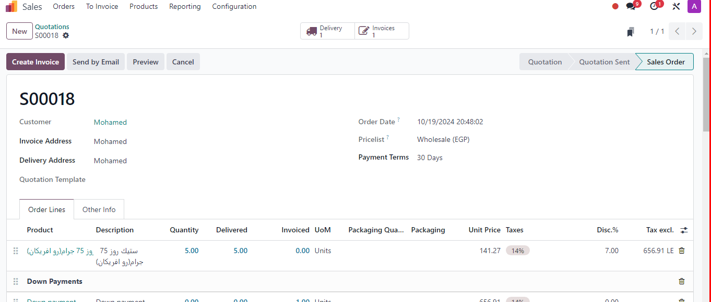
Sales Order :

Slide 36
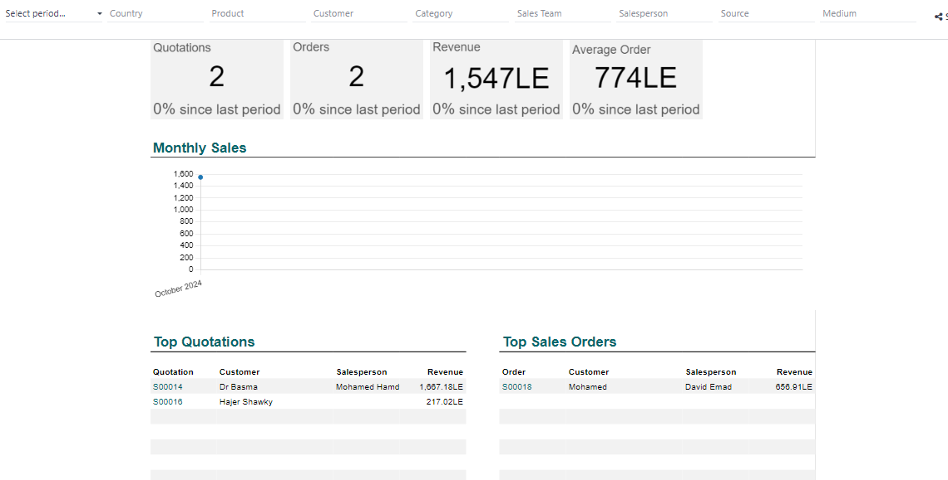
Sales Report :

Slide 37
Point of Sale

Slide 38
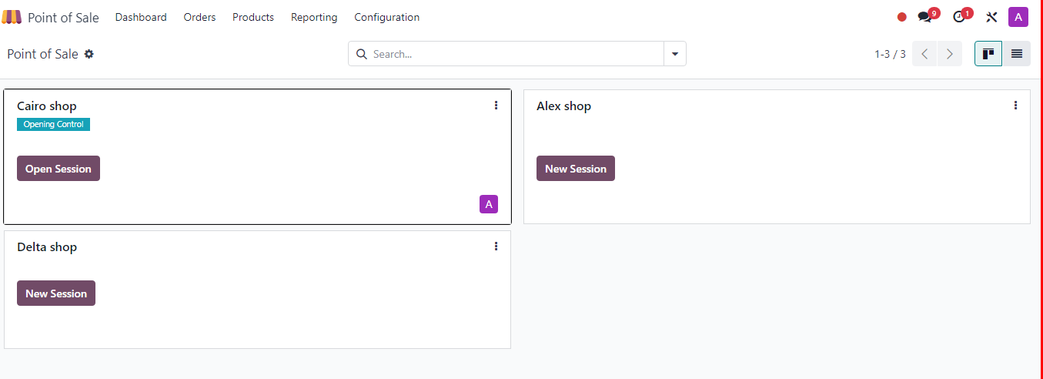
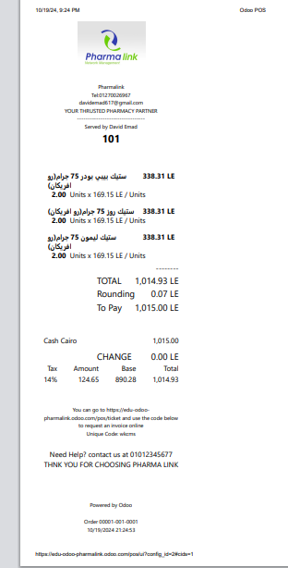
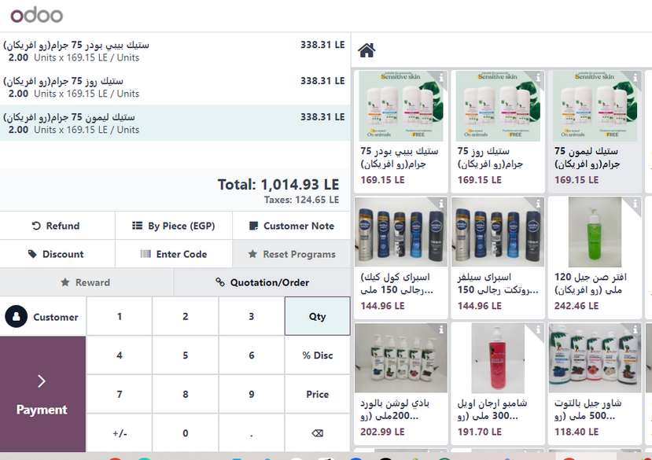
Point of Sale :

Slide 39
HR
Employees
organization chart
contracts

Slide 40
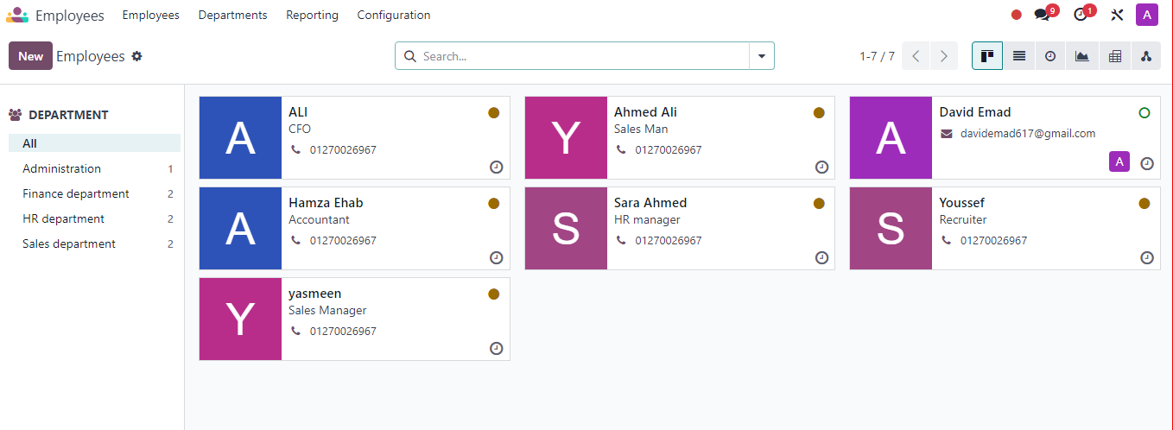
Employees

Slide 41
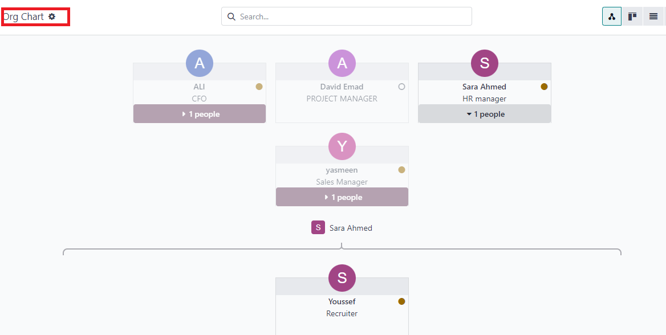
Organiztion Chart

Slide 42
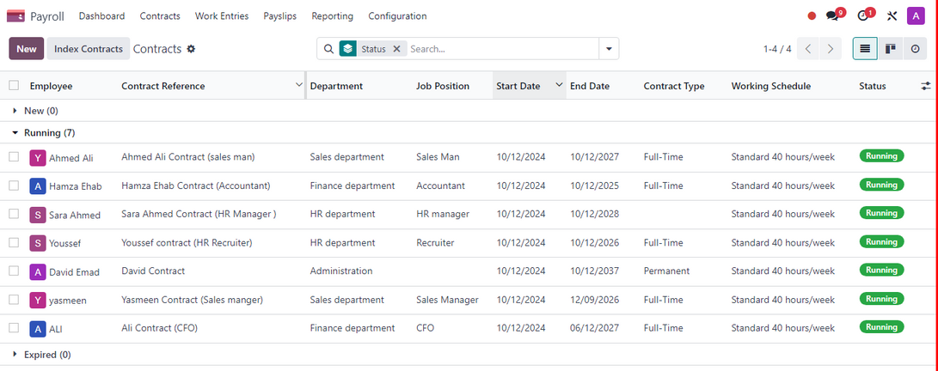
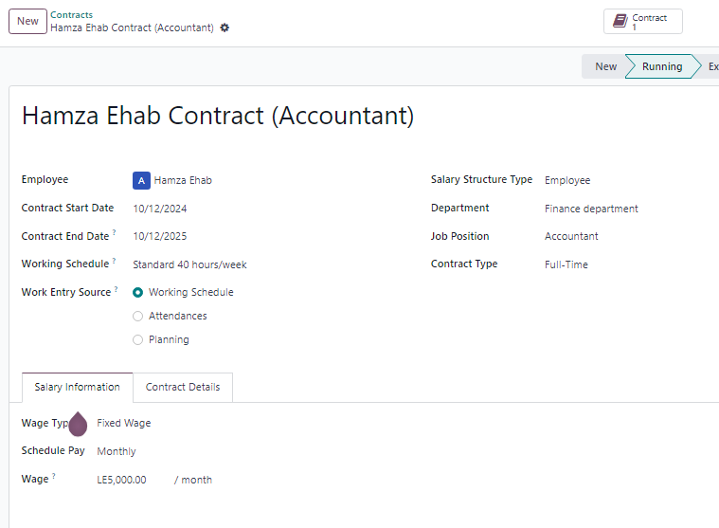
Contracts
Contracts Example

Slide 43
Accounting Module
chart of account
taxes
payment methods
Analytic Accouting
assets managment
Accounting Dashboard
Automated Journal Entries
Financial Statement

Slide 44
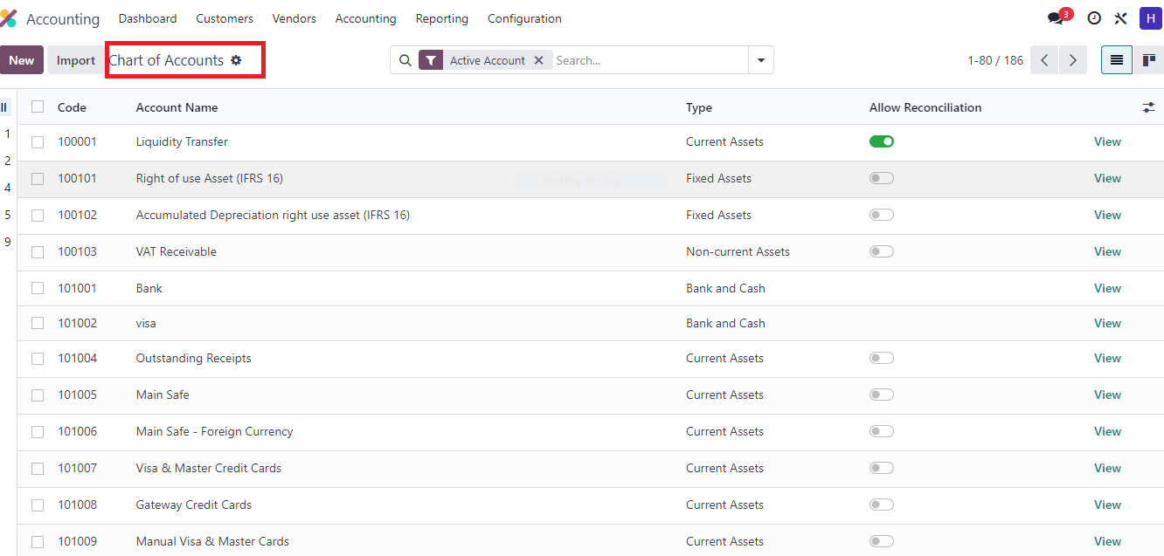
chart of account :

Slide 45
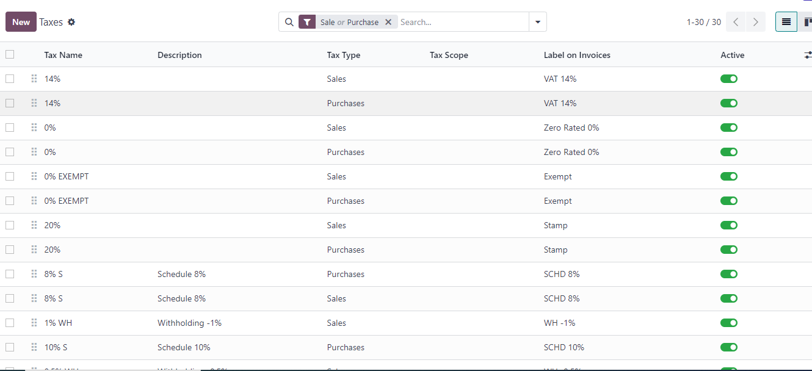
Taxes :

Slide 46
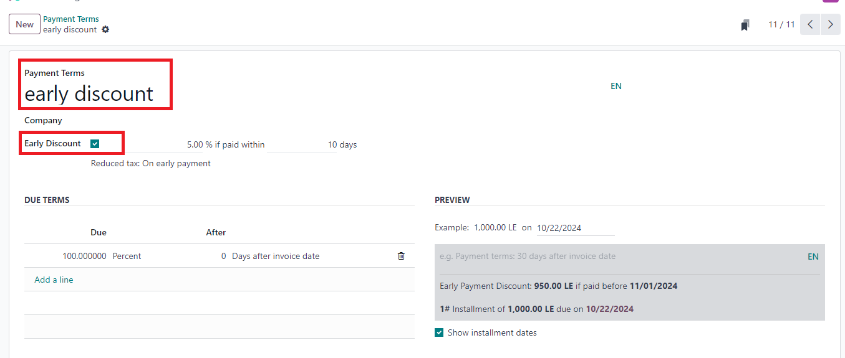
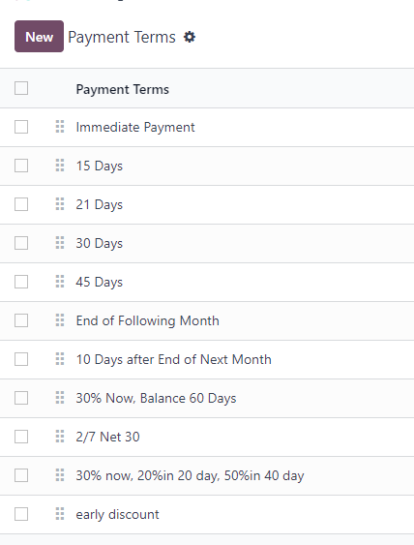
Payment Methods :

Slide 47
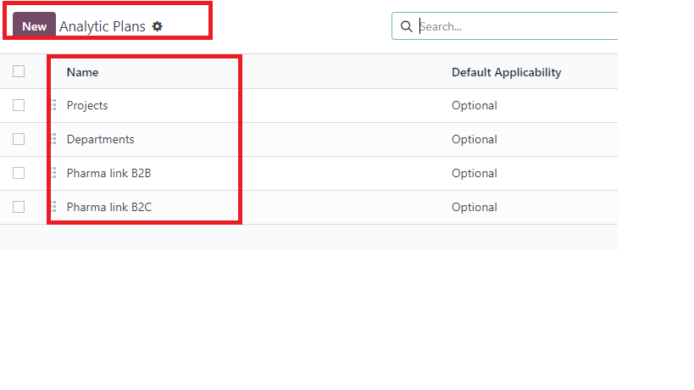
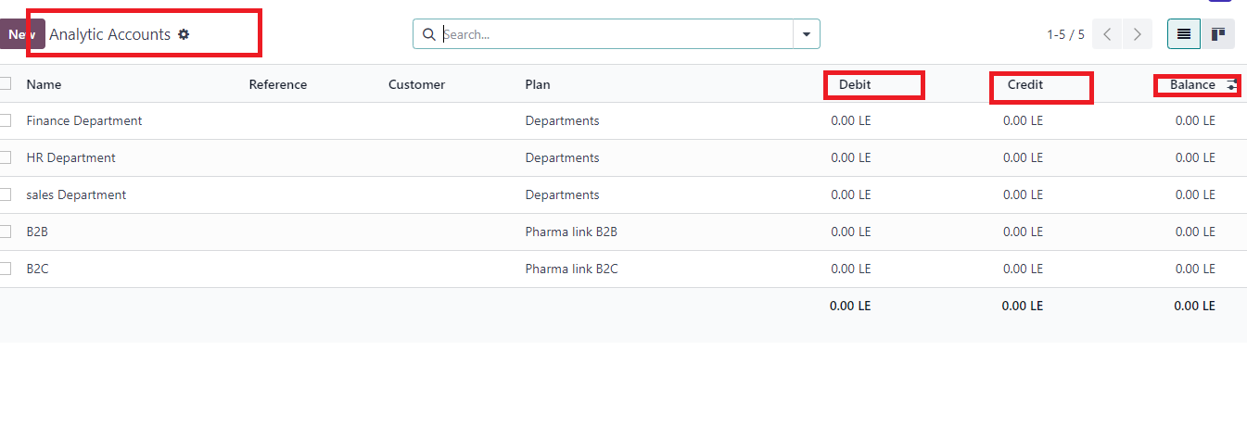
Analytic Accounting :
Analytic Plan
B2B , B2C Departments
Analytic Account

Slide 48
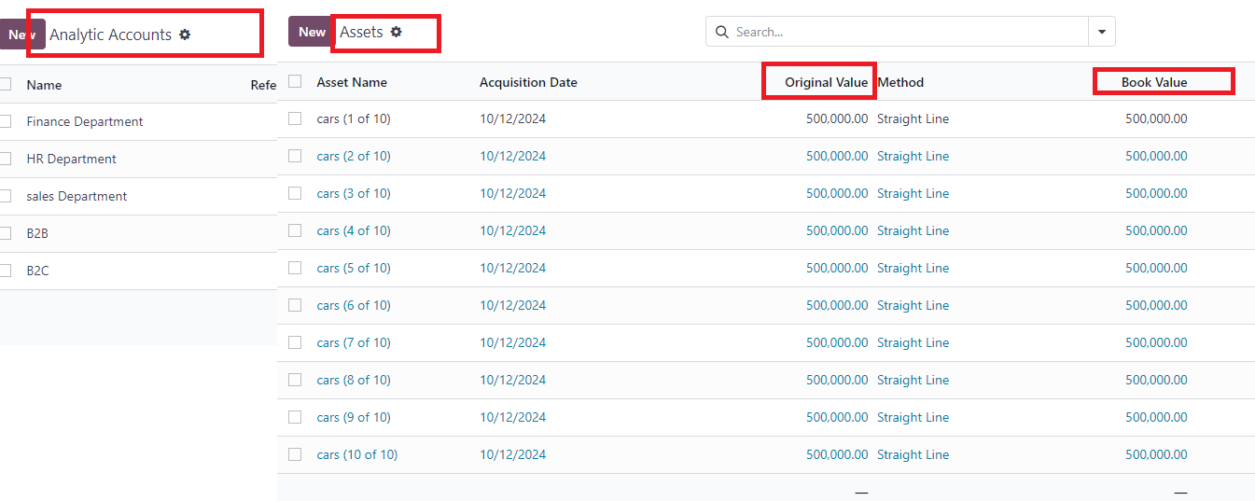
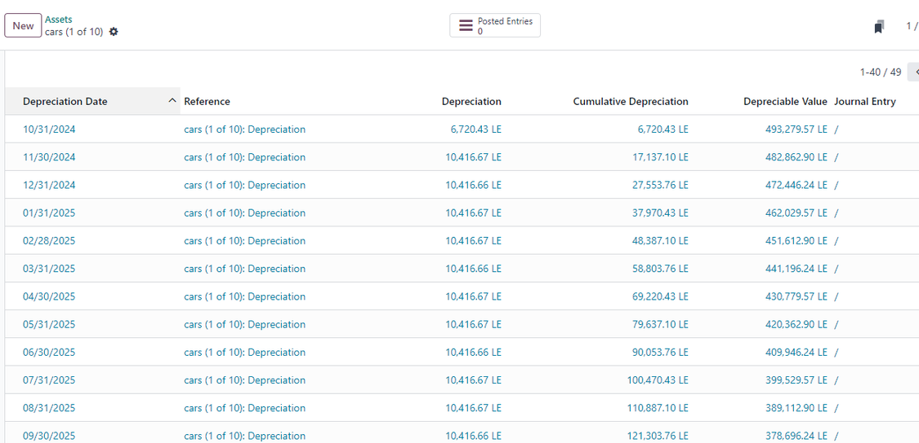
Assets Mangement :
Depreciation

Slide 49
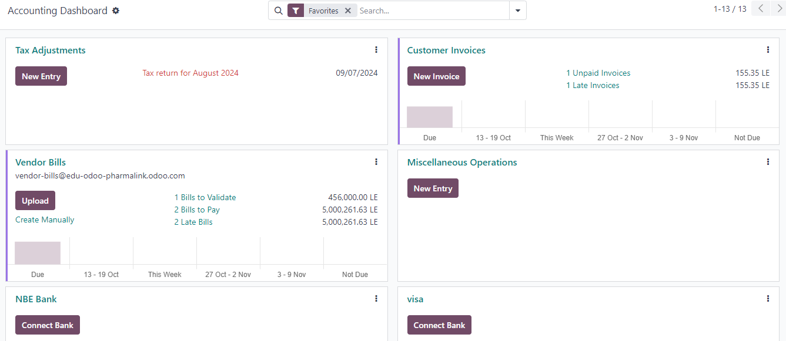
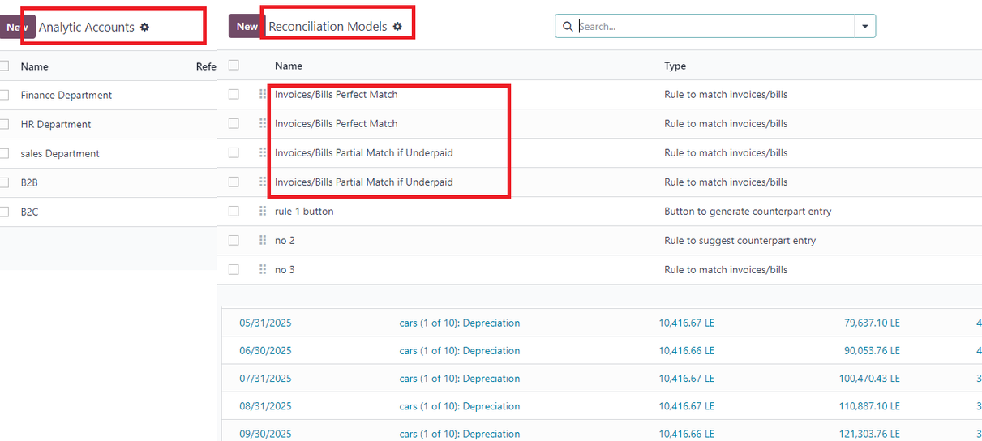
Accounting Dashboard :
RECONCILIATION MODELS

Slide 50
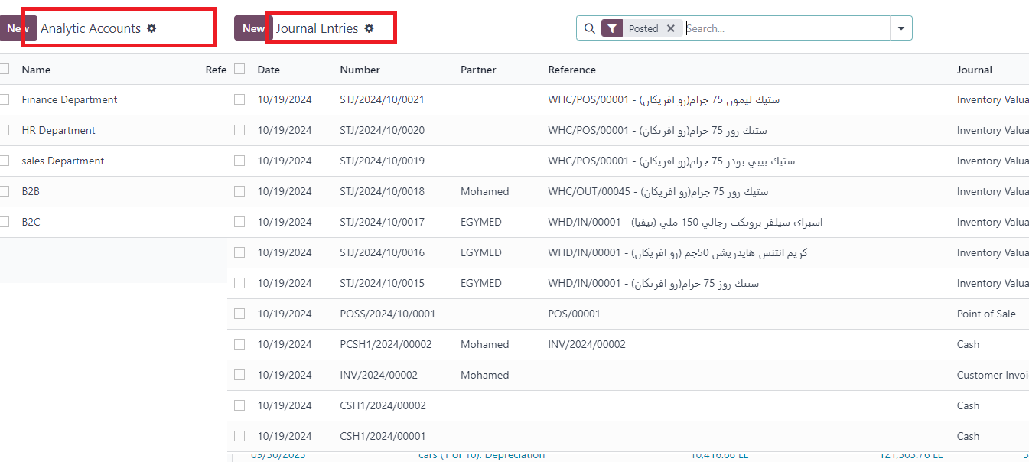
Automated Journal Entries :

Slide 51
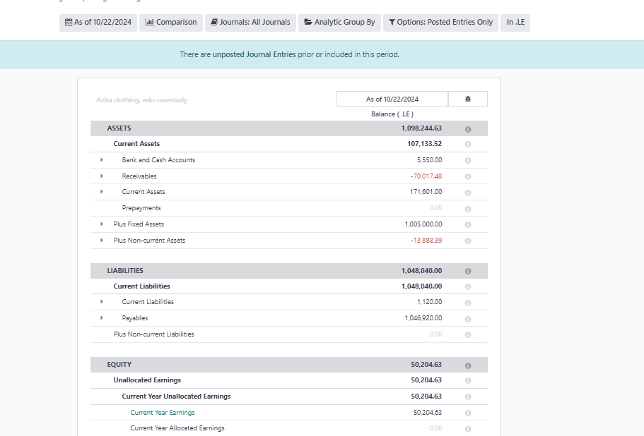

Financial Statement :
Balance Sheet
Income Statement

Slide 52

Website

Slide 53

E-Commerce

Slide 54
Thank You

